Slide 1
Integrated Water Replenishment and Management System
Niravra Kar (NUID: 001252638)
Prithvi Kamath (NUID: 001259251)
Ranadeep Guha (NUID: 001222665)

Slide 2
Problem Statement
Water shortage is one of the biggest problems plaguing various pockets of the world today.
By the time the officials are notified of the scarcity of water in their jurisdiction, there is a high chance that it turns into a crisis.
This results in drastic and unplanned replenishment actions which would result in a higher cost for the government.

Slide 3
Approach
We create a centralized framework which caters to the various water replenishment strategies and it’s respective costs based on the following parameters:
Soil Type of the regions
Artificial Source of Water
Interstate Transportation of Water
The system follows a governance hierarchy in dealing with work requests.

Slide 4
Work Flow Diagram

Slide 5
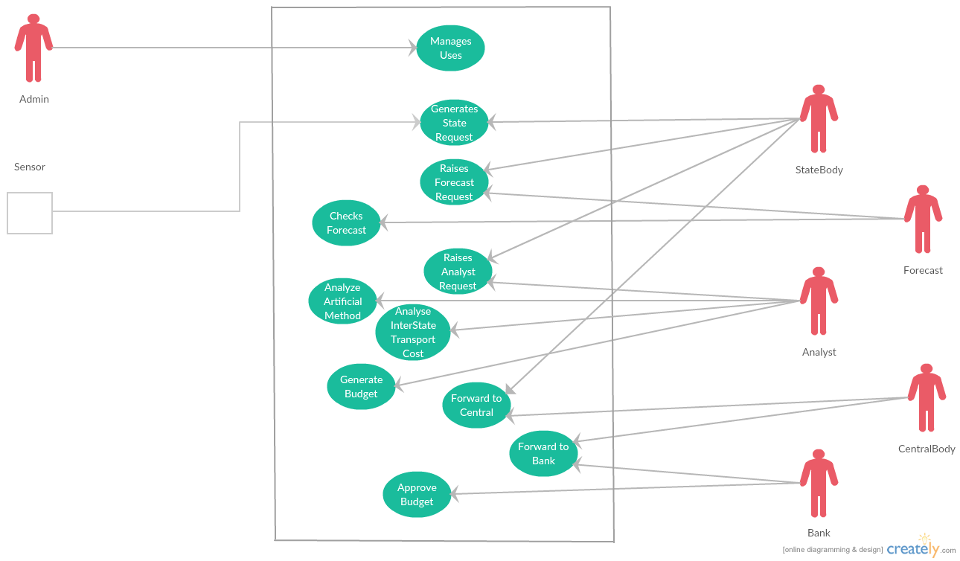
Use Cases

Slide 6
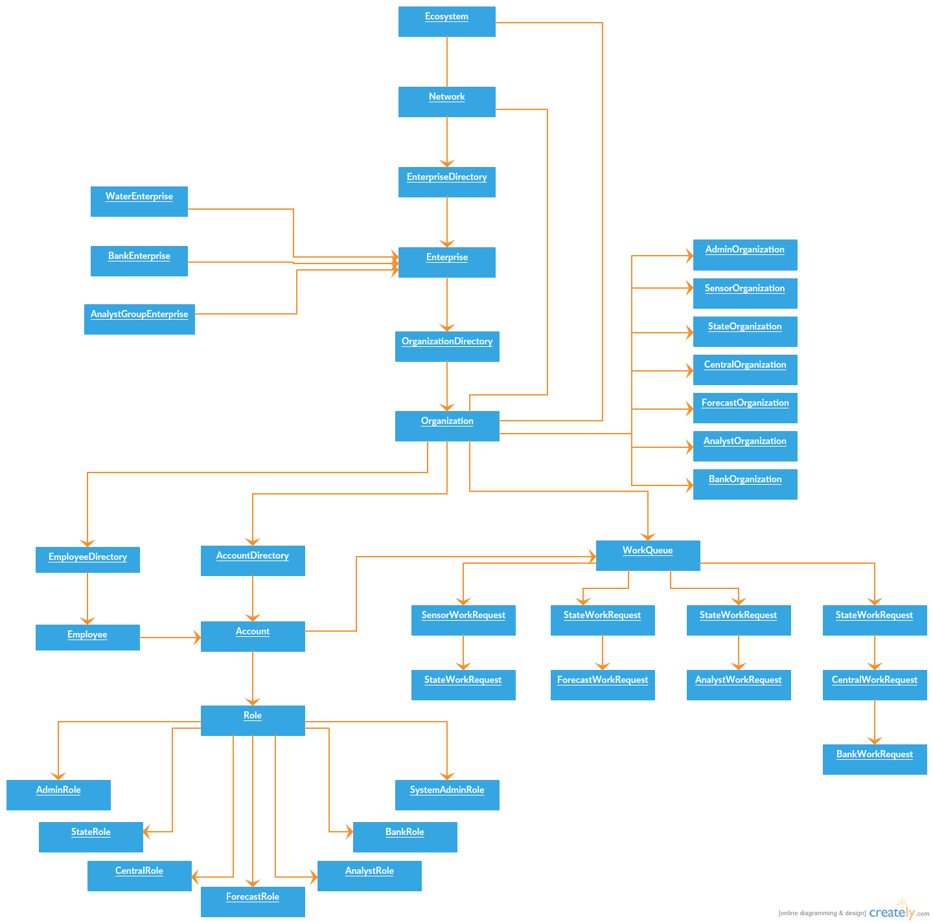
Object Model

Slide 7
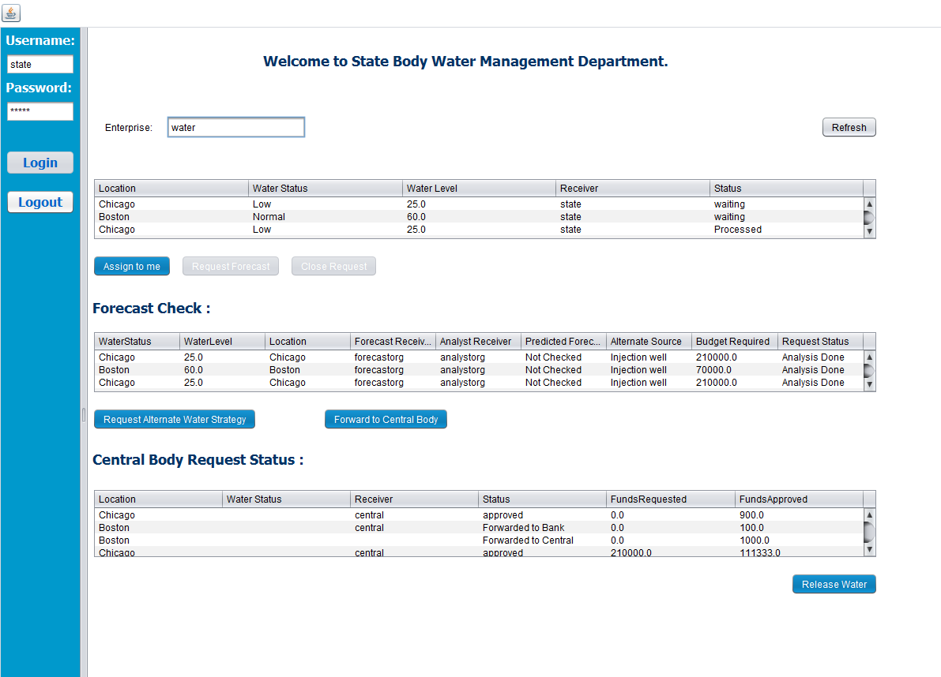
StateEmployeeWorkArea

Slide 8
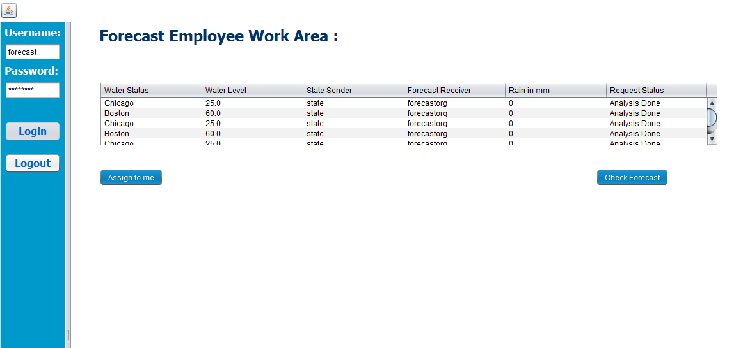
ForecastEmployeeWorkArea

Slide 9
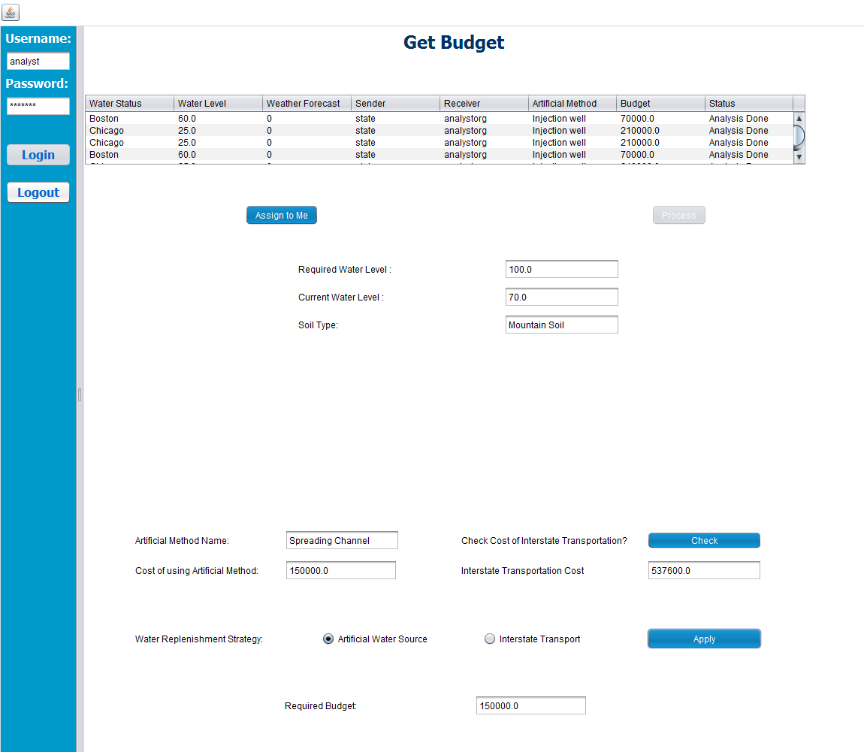
AnalystEmployeeWorkArea

Slide 10
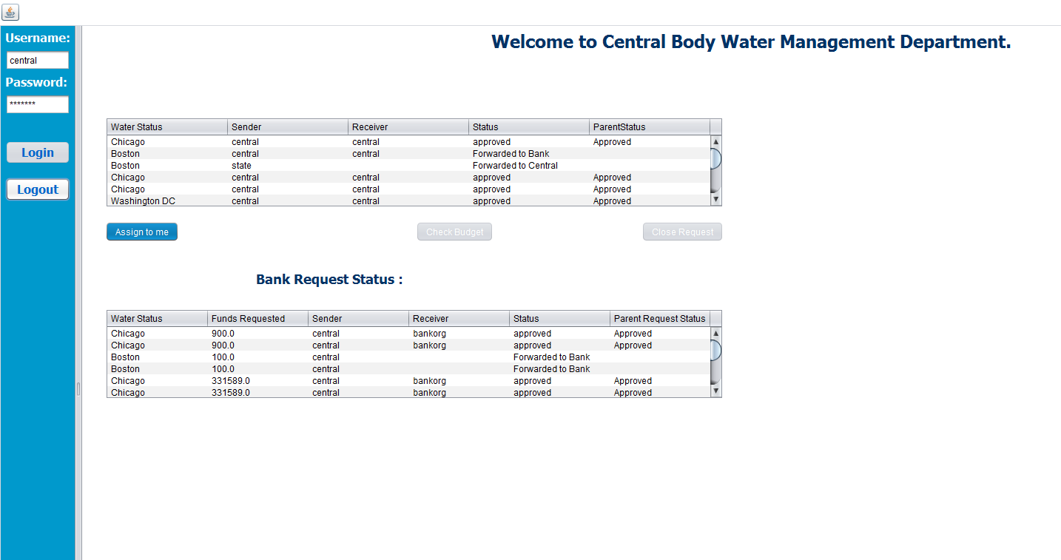
CentralEmployeeWorkArea

Slide 11
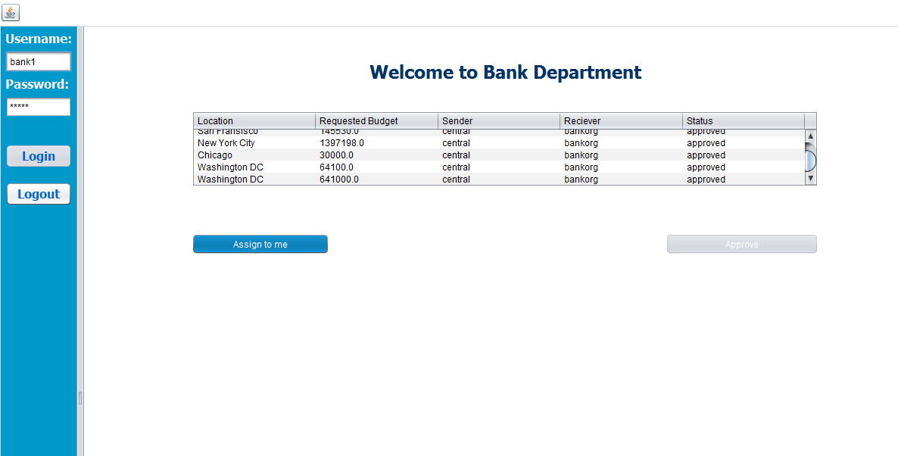
BankEmployeeWorkArea

Slide 12
References
http://www.businessinsider.com/americas-about-to-hit-a-water-crisis-2015-4
http://www.unep.or.jp/ietc/publications/techpublications/techpub-8e/artificial.asp
http://www.slideshare.net/my-will/groundwater-improvement-techniques
https://thumbs.dreamstime.com/z/save-earth-water-concept-23126305.jpg

Slide 13
Thank You

